Slide 1

Digital Portfolio
STUDENT NAME: M.Keerthika
REGISTER NO:2426j0667
NMID:2AAB676CA591E2298064E6211B9A4C4A
DEPARTMENT: Bsc(Information technology)
COLLEGE /UNIVERSITY : Kamalam college of arts and science, Bharathiyar University
1
Notes:
1

Slide 2

PROJECT TITLE
Interactive Digital portfolio using front end web development-UI UX designer
2

Slide 3



AGENDA
Problem Statement
Project Overview
End Users
Tools and Technologies
Portfolio design and Layout
Features and Functionality
Results and Screenshots
Conclusion
Github Link
3/21/2024 Annual Review
3

Slide 4

PROBLEM STATEMENT
In UI/UX design, creativity and user-focused solutions go beyond resumes. A digital portfolio helps showcase design process, wireframes, prototypes,
and real projects, reflecting a
designer’s ability to create
meaningful user experiences.
4

Slide 5

PROJECT OVERVIEW
This portfolio shows my work as a UI/UX designer. It includes my intro, key skills, top projects, personal strengths, and contact details. Each part is designed to reflect
my style, process, and growth in design.
5

Slide 6

WHO ARE THE END USERS
-Students – Use it to showcase academic projects, creativity, and growth in design skills.
- Job Seekers – Present their design process and work samples to apply for UI/UX roles.
- Freelancers – Share past client work and attract new projects through visual storytelling.
- Professionals – Highlight career achievements, leadership in design, and impact.
- Recruiters – Review portfolios to evaluate design thinking, skills, and potential fit.
6

Slide 7

TOOLS AND TECHNIQUES
-HTML – Page structure
- CSS – Styling and layout
- JavaScript – Scroll and form actions
- Media Queries – Mobile responsiveness
- Semantic Tags – Clean structure
- Form Elements – Contact form
- Hover Effects – Small interactions
7

Slide 8
POTFOLIO DESIGN AND LAYOUT
-Header Section – Title, intro, and button at the top
- Card Layout – White boxes for each section (About, Skills, Projects, etc.)
- List Style – Rounded boxes for skills and project points
- Contact Form – Neat form with name, email, and message
- Footer – Bottom part with copyright and "Back to Top" link
- Responsive Design – Works on mobile and desktop
- Hover Effects – Buttons and images zoom slightly when you touch them
- Gradient Background – Soft color blend in the background
- Circle Image Style – Profile photo with round shape and shadow
8

Slide 9
FEATURES AND FUNCTIONALITY
- Contact Form – Includes validation and feedback message
- Responsive Design – Works on mobile and desktop screens
- Card Layouts – Clean section blocks with shadows and spacing
- Hover Effects – Image and button zoom on hover
- Back to Top Link – Easy navigation to the top of the page
- Gradient Backgrounds – Visually appealing color transitions
- Circular Profile Image – Neatly cropped with border and shadow
- Semantic HTML Tags – Clean structure for accessibility and SEO

Slide 10
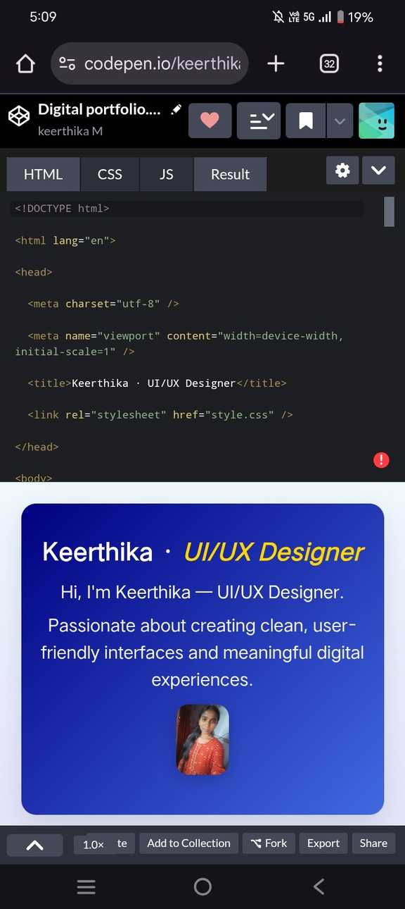

RESULTS AND SCREENSHOTS
Overall, it reflects strong UI/UX
skills with a focus on clarity,
Usability, and modern
presentation.
3/21/2024 Annual Review
10

Slide 11
CONCLUSION
This portfolio highlights
clean design, responsive layout, and smooth user experience through interactive features. It encourages better digital presentation for designers and helps users easily explore skills, projects, and contact options—benefiting both creators and the community
11

